Slide 1
Poverty Summit
August 26, 2023

Slide 2
Public housing authority for Salt Lake County
Currently serve 5,766 households
Average resident annual income is $13,041
Average resident monthly rent $326
Our mission is to connect people and communities to quality affordable housing opportunities while promoting self-sufficiency and neighborhood revitalization.

Slide 3
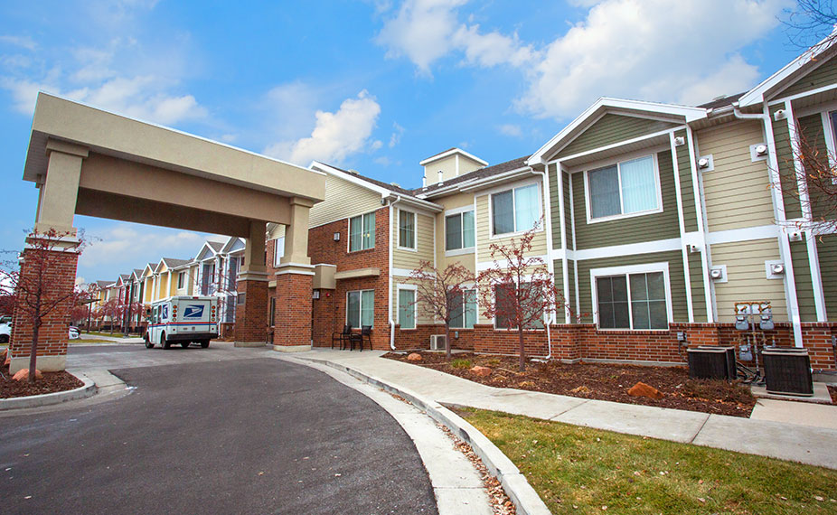
Section 8 Housing Choice Voucher Program
Major federal housing assistance program
Allows clients an opportunity to find housing anywhere.
Income limits and rents are determined by HUD.
Subsidy is paid to the landlord directly by the PHA on behalf of the clients.
Clients pay approximately 30% of income towards rent.
Targets clients who are very low-income

Slide 4
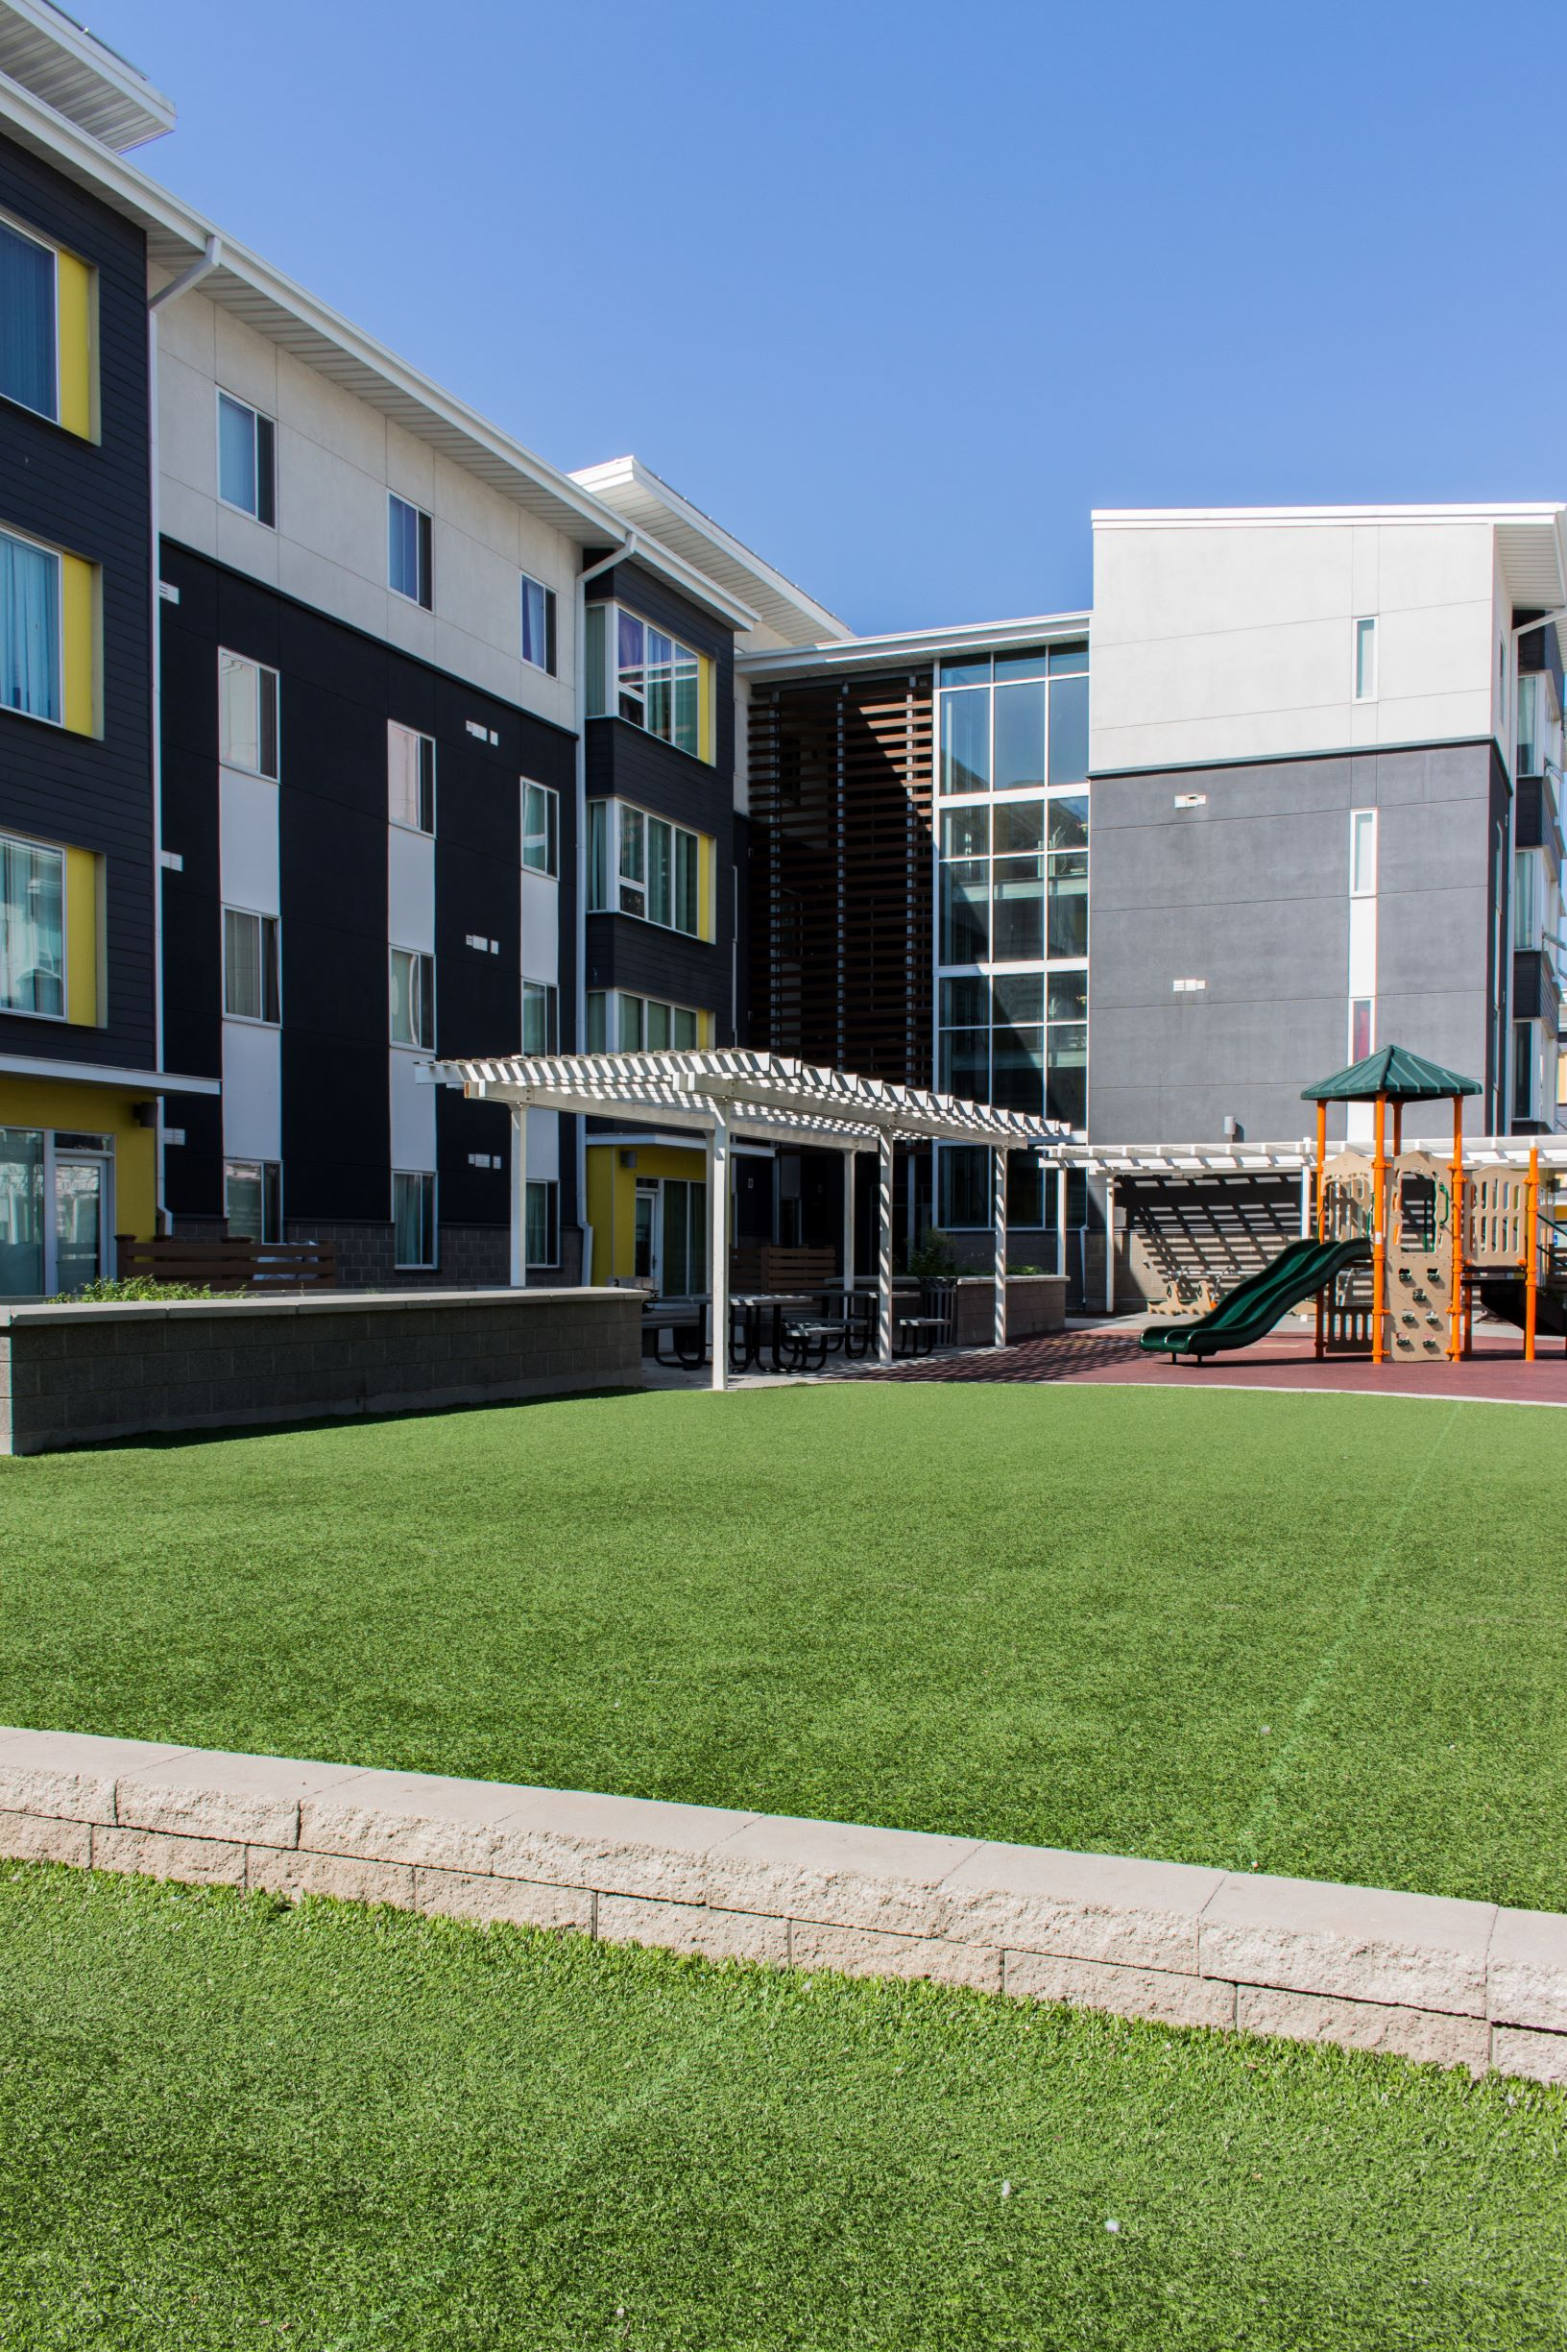
Section 8 Housing Choice Voucher PROGRAM
Nationally there are 2.67 M vouchers with 85% leased
In Utah there are 12,748 vouchers with 88% leased
In Salt Lake County there are 6,653 vouchers with 90% leased
Nationally, only one in four eligible households receive voucher assistance
In Salt Lake County there are over 5,500 on the waiting list
Challenges
Finding a unit
Vouchers pose extra requirements on landlords: paperwork/unit inspections
Fair Market Rents are set by HUD to cover modest apartment
Fair Market Rent current with market rents

Slide 5
Active Housing choice voucher holders in Salt lake county* * as of 3/2023

