Slide 1
Office of Homeless Services
State Homelessness Coordinator August 2023

Slide 2
Rates of Homelessness
Rates of individuals experiencing
homelessness per 10,000 people:
Utah - 11 per 10,000
Mississippi - 4 per 10,000
South Carolina - 7 per 10,000
Alabama - 7 per 10,000
California - 44 per 10,000
Vermont - 43 per 10,000
Oregon - 42 per 10,000

Slide 3
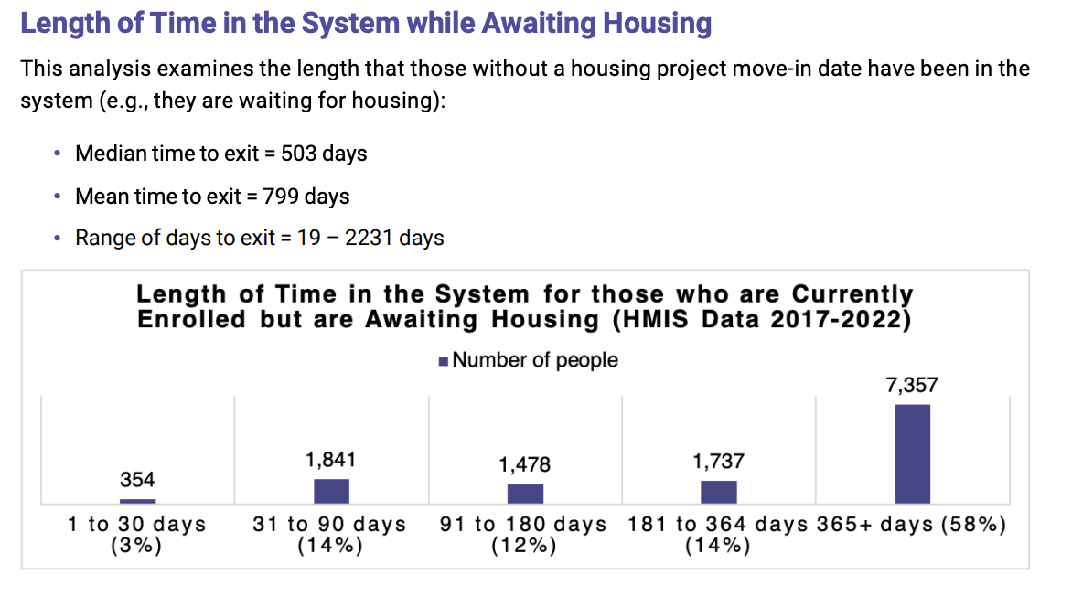

Slide 4
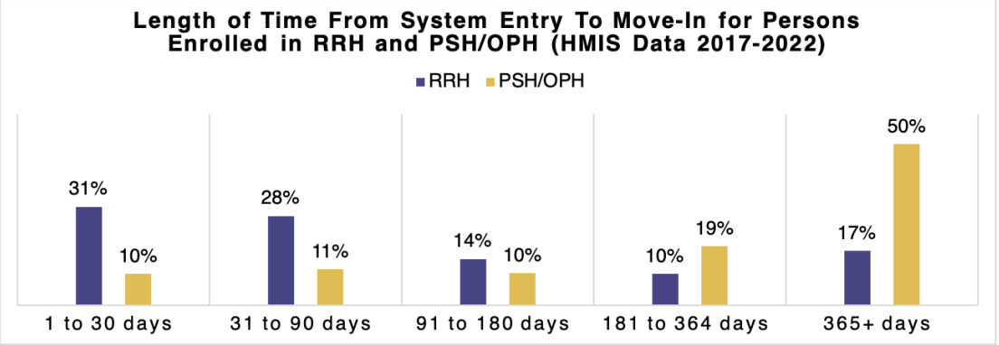
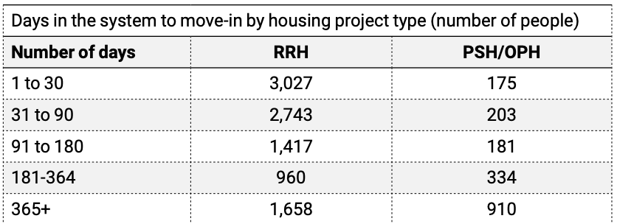

Slide 5
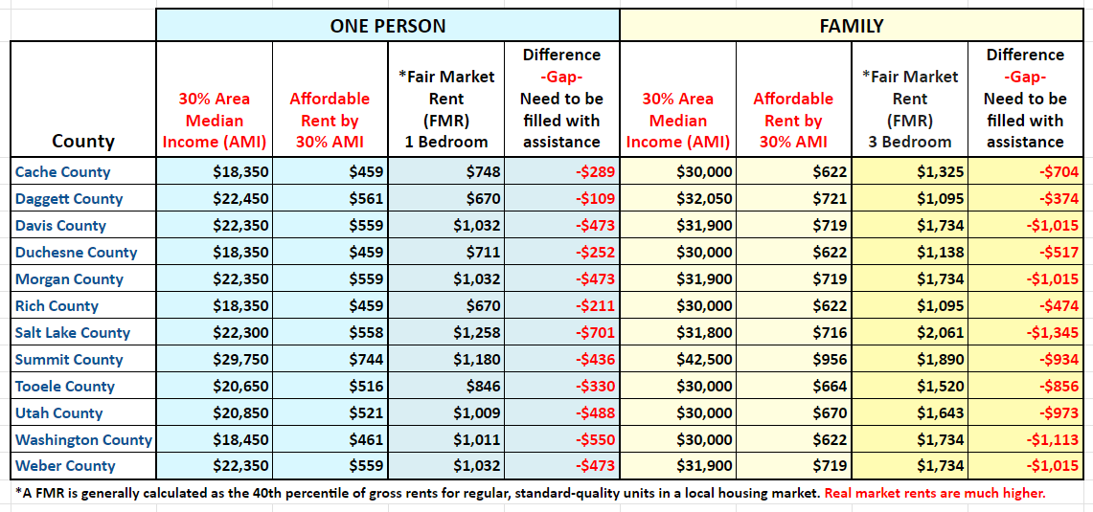

Slide 6
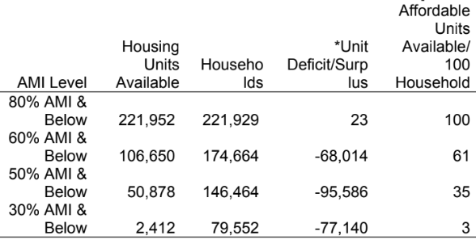
Affordable & Deeply Affordable Housing Need
As part of House Bill 462 passed in 2022, the Department of Workforce Services has contracted with the Gardner Policy Institute (GPI) to develop a database of moderate and affordable housing needs and supply across Utah.
The GPI team has provided initial estimates showing cumulative surplus/deficit for four area median income (AMI) levels for calendar year 2022.

Slide 7
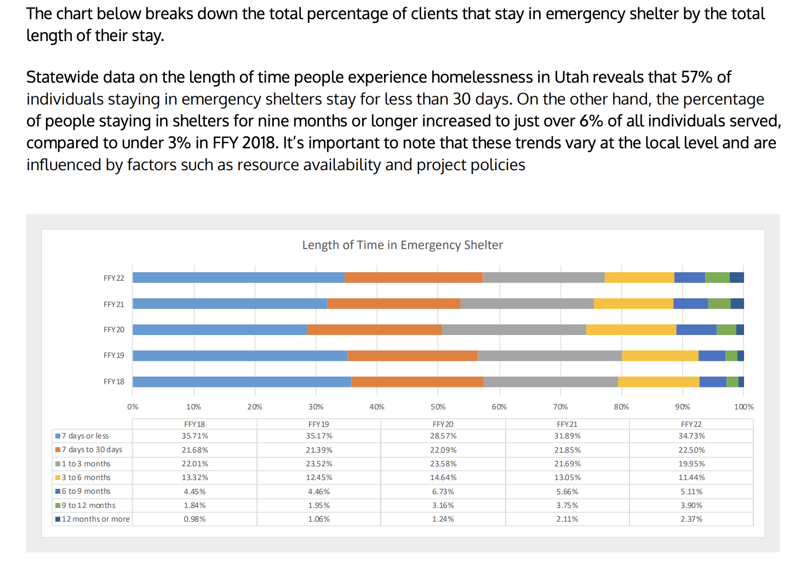
Shelter Data

